Slide 1
CVSD Final Project Presentation
Group 41
R06843086 張奕凡 R06943087 葉玲瑜

Slide 2
OUTLINE
RTL code
Synthesis
APR

Slide 3
RTL code
SRAM: 256x16 and 512x16
Divided into four rounds to load from SRAM: 4bit/round
剩下給你補充惹Q__Q
我先去弄GM的報告

Slide 4
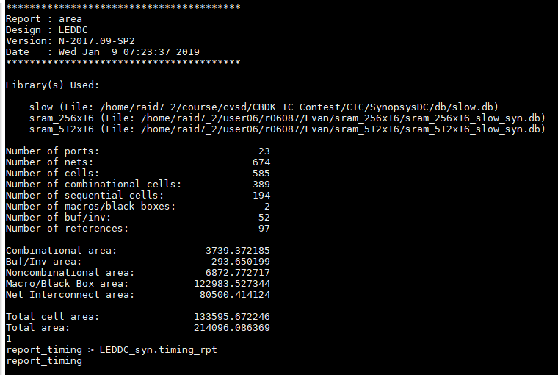
Synthesis
Using compile_ultra
-area
-retime
Area after synthesis

Slide 5
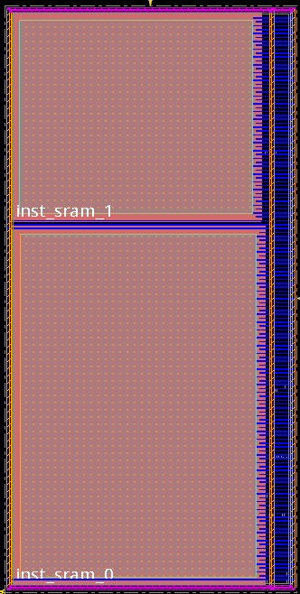
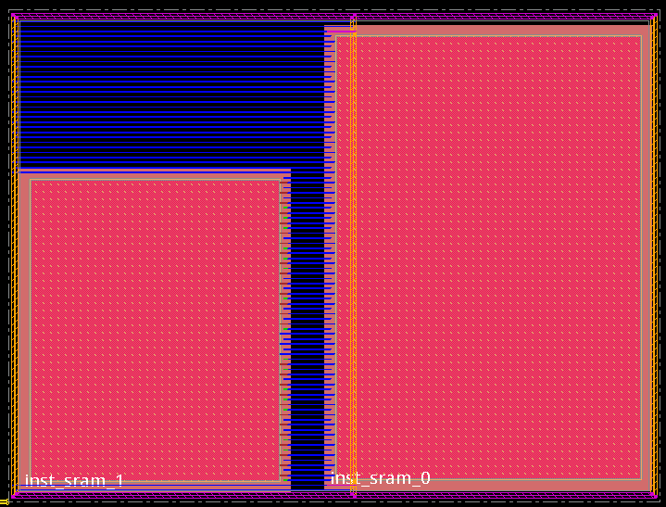
APR - Placement
The most important thing is how to place SRAM

Slide 6
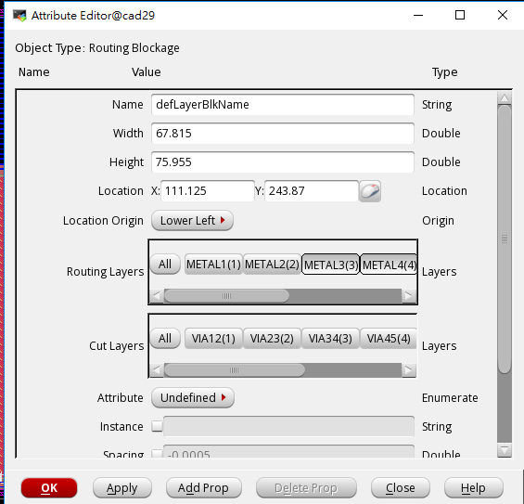

APR – Routing
Metal 3 cut short violation
Routing blockage

Slide 7
APR
Save design before going to the next step!!!
ECO (optimization design)
Try and error
And pray xDDDD

Slide 8
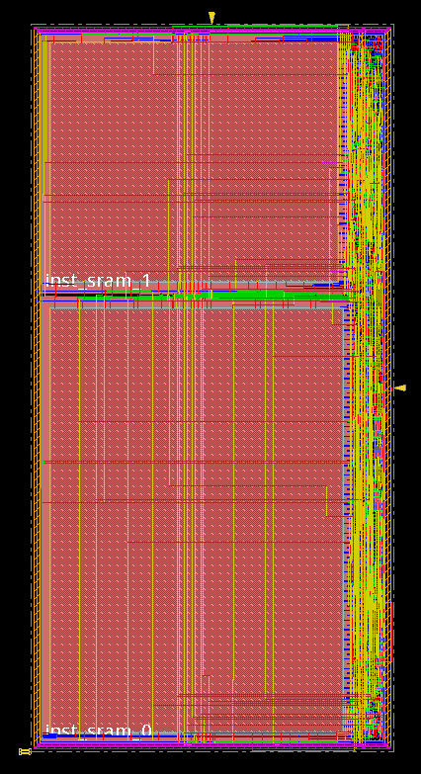
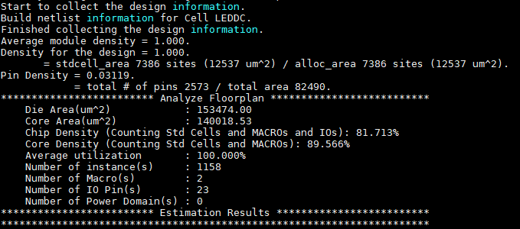
Result

Slide 9
Thanks for your attention.

